Slide 1
Acoustic Modeling
by Ming-Yi Tsai
pancho@speech.ee.ntu.edu.tw

Slide 2
Outline
Concept of speech recognition
Hidden Markov model
Parameters of HMM
Acoustic model for Mandarin Chinese

Slide 3
Outline
Context-dependent acoustic model
Triphone
  Buttom-up
  Top-down(decision tree)

Slide 4
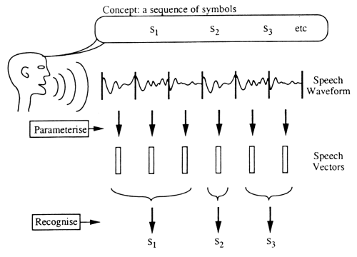
Concept of speech recognition

Slide 5
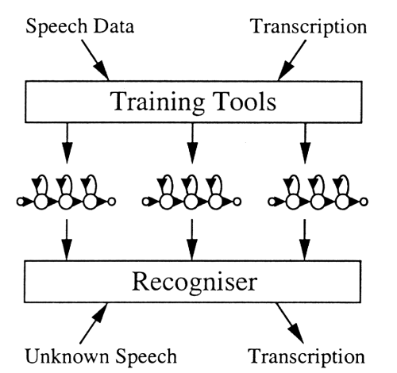
Concept of speech recognition

Slide 6
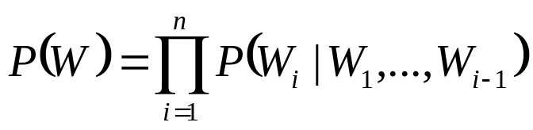
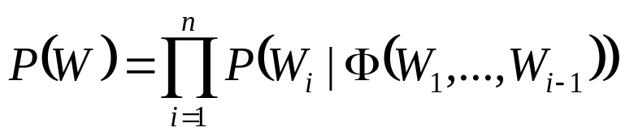
Concept of speech recognition
Acoustic processing
  Pressure waveform => a_{i}
Acoustic modeling
  a statistical model to compute P(A|W)
Language modeling

Slide 7
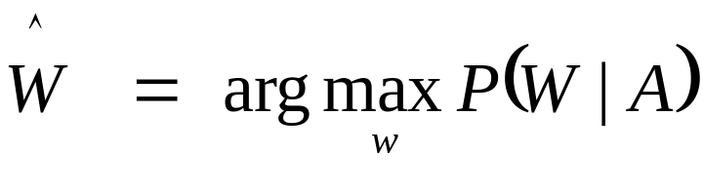
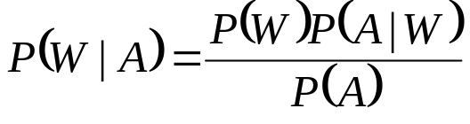
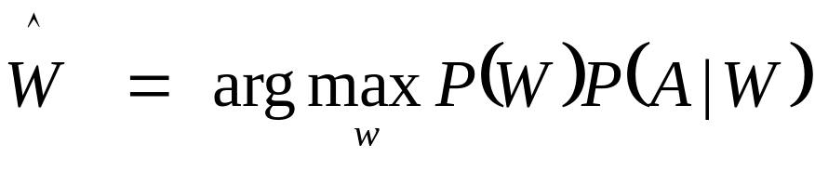
Mathematical formulation
    Let A=a₁, a₂,… a_{m} denote the acoustic evidence
    W =w₁, w₂,… w_{n} denote a string of n words

Slide 8
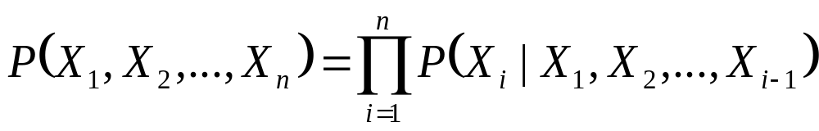
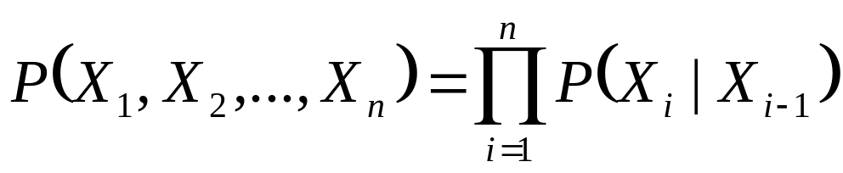
Markov Chains
    Let X₁, X₂,… ,X_{n},… be a sequence of random variables taking their values in the same finite alphabet Χ={1,2,…,c}

Slide 9
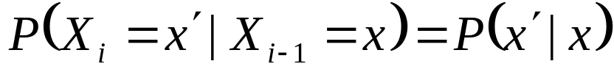
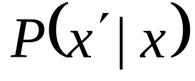
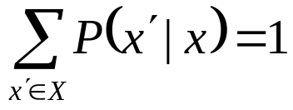
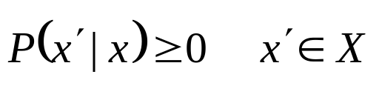
Markov Chains
The Markov chain is time invariant or homogeneous if
  is called the transition function
  must for all x ∈ Χ satisfy the usual conditions
for all x,x′∈ Χ

Slide 10
HMM limitations
Weak duration modeling
The assumption of conditional independence of observations given the state sequence
The restrictions on feature extraction imposed by frame-based observations.

Slide 11
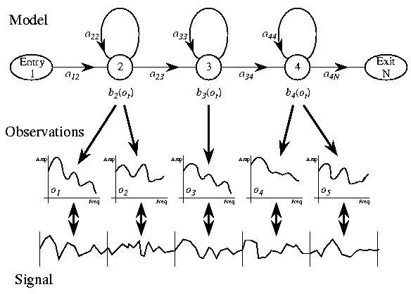
Hidden Markov Model (HMM)

Slide 12
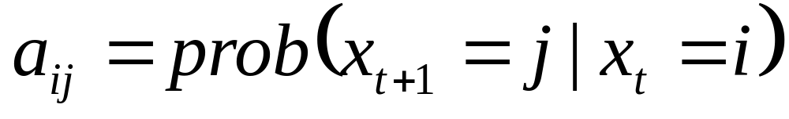

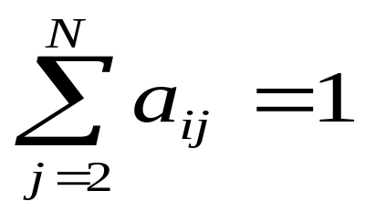
Transition probabilities
is assumed to be constant and does not vary over time.
,for i=1,2,… ,N-1

Slide 13
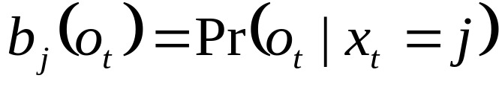
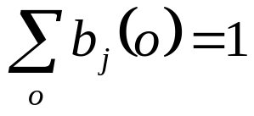
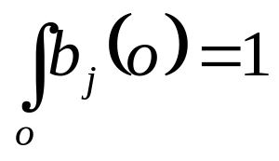
Output probabilities
For all emitting sates j=2,…,N-1
  for discrete distributions.
  for continuous distributions.

Slide 14
Output probabilities
Continuous
Discrete
Tied-mixture

Slide 15
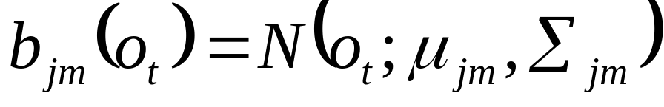
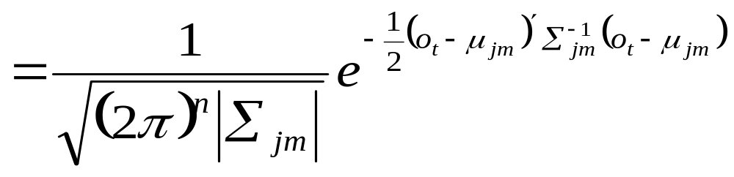
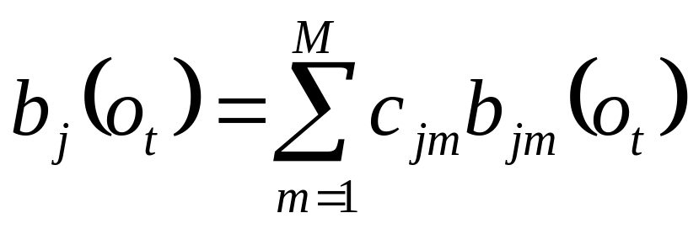
Output probabilities
Continuous:

Slide 16
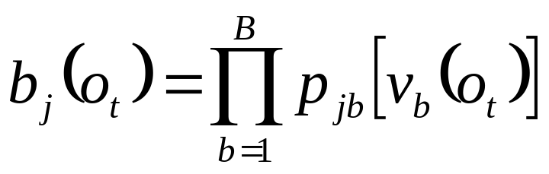
Output probabilities
Discrete:
  The observations are quantized into a number of symbols
  The symbols are normally generated by a vector quantizer
  it is often necessary to break the observation vector into several streams

Slide 17
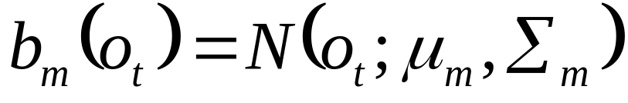
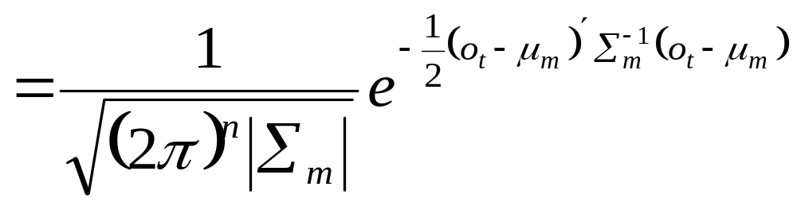
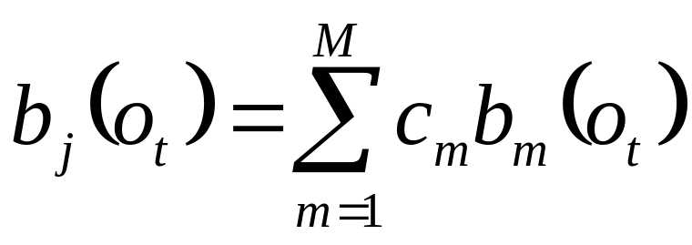
Output probabilities
Tied-mixture:

Slide 18
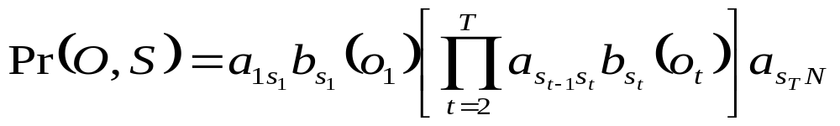
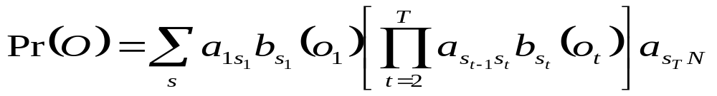
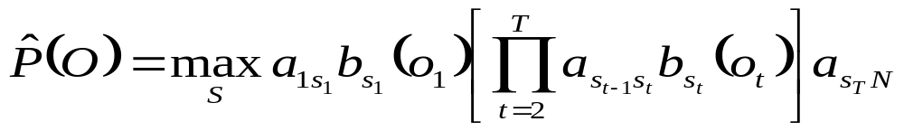
Hidden Markov Model
state sequence will be hidden
approximation

Slide 19
HMM for speech recognition
The re-estimation procedure is robust enough
the choice of the basic modeling unit for a system

Slide 20
Characteristics of Mandarin Chinese
There are at least word, character, syllable, Initial-Final levels in Chinese
A monosyllabic-structure language
A Chinese word is then composed of one to several characters
In the Chinese writing system, there is no word boundaries

Slide 21
Characteristics of Mandarin Chinese
In general,there are
  more than ninety thousand frequently used words
  at least ten thousand frequently used characters
  only about 418 base-syllables (disregarding the tones)
  1360 tonal syllables (including the differences in tones)

Slide 22
Characteristics of Mandarin Chinese
Traditional Chinese phonology decomposed the syllable into an Initial and a Final
  The Initial is the way a syllable begins, usually with a consonant
  A small number of syllables do not begin with a consonant(they are said to begin with the zero Initial)
  The Final of a syllable is the syllable minus the Initial
There are about 21 Initials and 36 Finals in Mandarin

Slide 23
Acoustic Model Units of Continuous Mandarin Chinese
注音符號
Phone model:
  IPA(International Phonetic Alphabet)
  Pinyin
  SAMPA-T(Speech Assessment Methods Phonetic Alphabet-Taiwan)
Initial-Final model
Premetoneme

Slide 24
Premetoneme
Initials
--------------------------------------------------------------------------
b (ㄅ) bu (ㄅ) bi (ㄅ) p (ㄆ) pu (ㄆ) pi (ㄆ)
m (ㄇ) mu (ㄇ) mi (ㄇ) f (ㄈ) fu (ㄈ)
d (ㄉ) du (ㄉ) di (ㄉ) t (ㄊ) tu (ㄊ) ti (ㄊ)
n (ㄋ) nu (ㄋ) ni (ㄋ) nU (ㄋ) l (ㄌ) lu (ㄌ) li (ㄌ) lU (ㄌ)
g (ㄍ) gu (ㄍ) k (ㄎ) ku (ㄎ)
h (ㄏ) hu (ㄏ) j (ㄐ) ji (ㄐ) jU (ㄐ)
< (ㄑ) <i (ㄑ) <U (ㄑ) T (ㄒ) Ti (ㄒ) TU (ㄒ)
Z (ㄓ) Zu (ㄓ) C (ㄔ) Cu (ㄔ)
S (ㄕ) Su (ㄕ) R (ㄖ) Ru (ㄖ)
z (ㄗ) zu (ㄗ) c (ㄘ) cu (ㄘ)
s (ㄙ) su (ㄙ) # (空) #i (空) #u (空) #U (空)

Slide 25
Premetoneme
Finals
-------------------------------------------------------------------------
e0 (ㄜ) i0 (ㄧ) y0 (空) Y0 (空) a0 (ㄚ) o0 (ㄛ) E0 (ㄝ) aN0 (ㄤ) au0 (ㄠ)
e1 (ㄜ) i1 (ㄧ) u1 (ㄨ) U1 (ㄩ) y1 (空) Y1 (空) a1 (ㄚ) o1 (ㄛ) E1 (ㄝ) aN1 (ㄤ) an1 (ㄢ) au1 (ㄠ)
e2 (ㄜ) i2 (ㄧ) u2 (ㄨ) U2 (ㄩ) y2 (空) Y2 (空) a2 (ㄚ) o2 (ㄛ) E2 (ㄝ) aN2 (ㄤ) an2 (ㄢ) au2 (ㄠ)
e3 (ㄜ) i3 (ㄧ) u3 (ㄨ) U3 (ㄩ) y3 (空) Y3 (空) a3 (ㄚ) o3 (ㄛ) E3 (ㄝ) aN3 (ㄤ) an3 (ㄢ) au3 (ㄠ)
e4 (ㄜ) i4 (ㄧ) u4 (ㄨ) U4 (ㄩ) y4 (空) Y4 (空) a4 (ㄚ) o4 (ㄛ) E4 (ㄝ) aN4 (ㄤ) an4 (ㄢ) au4 (ㄠ)
ou0 (ㄡ) en0 (ㄣ)
eN1 (ㄥ) oN1 (ㄨㄥ) N1 (ㄧㄥ) Ei1 (ㄟ) ai1 (ㄞ) ou1 (ㄡ) en1 (ㄣ) er1 (ㄦ) En1 (ㄧㄢ)
eN2 (ㄥ) oN2 (ㄨㄥ) N2 (ㄧㄥ) Ei2 (ㄟ) ai2 (ㄞ) ou2 (ㄡ) en2 (ㄣ) er2 (ㄦ) En2 (ㄧㄢ)
eN3 (ㄥ) oN3 (ㄨㄥ) N3 (ㄧㄥ) Ei3 (ㄟ) ai3 (ㄞ) ou3 (ㄡ) en3 (ㄣ) er3 (ㄦ) En3 (ㄧㄢ)
eN4 (ㄥ) oN4 (ㄨㄥ) N4 (ㄧㄥ) Ei4 (ㄟ) ai4 (ㄞ) ou4 (ㄡ) en4 (ㄣ) er4 (ㄦ) En4 (ㄧㄢ)

Slide 26
Pronunciation variation
Variation kinds:
  Assimilation
  Co-articulation(context-dependent)
  Reduction
  Deletion
  Insertion
Variation can be drawn between:
  Inter-speaker variation(social)
  Intra-speaker variation(stylistic)
  (not independent)

Slide 27
Contextual condition
ㄉㄧㄢˋ ㄉㄨㄥˋ ㄨㄢˊ ㄐㄩˋ
Context-independent
di En d oN #u an j U
Left-context dependent
*-di di-En En-d d-oN oN-#u #u-an an-j j-U
Right-context dependent
di+En En+d d+oN oN+#u #u+an an+j j+U U+*
Triphone
sil-di+En di-En+d En-d+oN d-oN+#u oN-#u+an #u-an+j an-j+U j-U+sil
Notes:
These new higher new order models tend to require more computation the HMM’s but with progressive search techniques, they are viable and of interest for current systems.(1)
Three HMM limitations: weak duration modeling, the assumption of conditional independence of observations given the state sequence, and the restrictions on feature extraction imposed by frame-based observations.(1)
Inclusion of explicit state duration density in HMM : (F358)
A simple mechanism for capturing time dependence is to augment the observation space with feature derivatives. In addition, several variations of HMM’s have been proposed to explicitly model correlation, including conditionally Gaussian HMM’s and Segmental HMM’s (SM).(1)
HMMs are very effective and efficient to model subtle details of speech signals by using one state for each quasi-stationary region. However, the transitions between quasi-stationary regions are largely neglected by HMMs. In contrast, segment models (SM) are powerful in modeling the transitions and longer-ranger speech dynamics, but usually require many compromises in reducing the complexity for their implementation.(2)

Slide 28
Triphone
Why is it proposed
Too many triphones:
  79 ------>34,000
  How to combine similar triphone
Sparse data problem:
  Backing-off
  Smoothing
  Sharing

Slide 29
Triphone
Sharing approaches
  Bottom-up sharing approach
    generalized triphone (model-level)
    shared-distribution model (state-level)
  Top-down sharing approach
    senonic decision tree

Slide 30
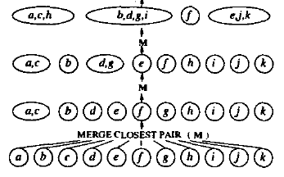
Generalized Triphone
Bottom-up merging procedure

Slide 31
Generalized Triphone
Bottom-up merging procedure
  Generate an HMM for each triphone context
  Create clusters of triphones, with each cluster consisting of one triphone initially
  Find the most similar pair of clusters that represents the same phone, and merge them
  For each pair of clusters, consider moving every element form one to the other.
    Move the element if the resulting configuration is an improvement
    Repeat until no such moves are left
  Until some convergence criterion is met, go to step 3)

Slide 32
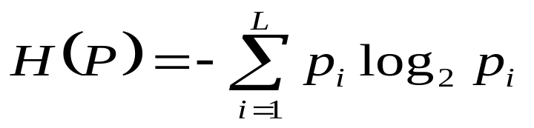
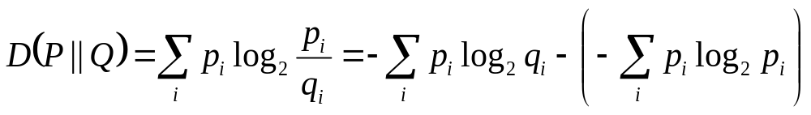
Generalized Triphone
Information-theoretical measure
    Given a discrete probability distribution (pd) P With L entries, the entropy is defined as
Cross-entropy
    The cross entropy (directed divergence) between two pd’s P and Q is defined as

Slide 33
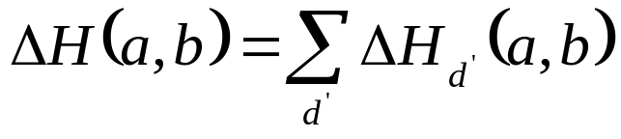
Generalized Triphone
The information loss when a distribution d for context a and b are merged into m, weighted by counts, is
The information loss when two HMMs for context a and b are merged,weighted by counts, is

Slide 34
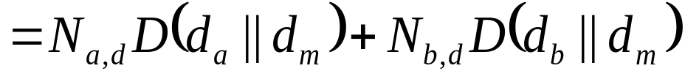
Generalized Triphone
The information loss when a distribution d for context a and b are merged into m, weighted by counts, is
Empirically find the “ Right ” number of models for any given amount training date

Slide 35
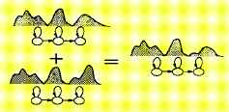
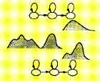
Shared-distribution model(SDM)
Why is it proposed?
Generalized Triphone
SDM

Slide 36
Senonic decision tree
Why is it proposed
  Bottom-up
    purely data driven
    Unseen triphones are usually backed off to the corresponding CI phones
Inherits of the merits of SDM
The ability to model unseen triphones
How to combine similar triphones

Slide 37
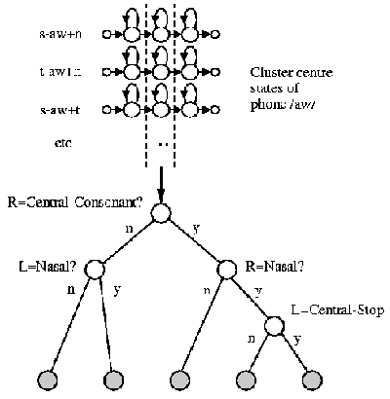
Top-down(decision tree)

Slide 38
Senonic decision tree algorithm
Locate a (small) set linguistic questions manually
For each phone p
    Estimate all p-triphones HMMs
    For each Markov state k in the model topology, classify all the k-th output distribution in all p-triphones using a binary tree
  Put all the k-th output distributions of all p-triphones into the root node
  Find the best question for the root and compute the entropy reduction
  Split the node with the most entropy decrease. By splitting, all the pds that come from the triphones which answer yes to the question go to the yes-child nod; those which answer no to the no-child node
  Find the best question and compute the entropy reduction for each of the newly created children
  Go to step c) unless some stop-growing criterion is met
Notes:
Put all the k-th output distributions of all p-triphones into the root node

Slide 39
Senonic decision tree algorithm
The stop criterion are similar as bottom-up procedure
  Minimal entropy reduction
  Minimal occurrence counts of each node (cluster)
Notes:
Put all the k-th output distributions of all p-triphones into the root node

Slide 40
Conclusion
Selecting of Acoustic unit
  The subtlest model has best performance with enough training data
Search space
Number of parameters
Selecting of question set in decision tree

